Slide 1
Cloud Boot Camp
Bluemix Intermediate
Shanghai China
June 10 -12 2015

Slide 2
Bold Play Messaging
Realized Innovation:
Idea →Workshops → PoCs → Adoption → Transformations
Innovate
Boutique Partners
Agile Cloud ect..
Organization
Skills
External Hire
Differentiated Apps
API Economy
3 Speed IT
Transform Services, SoRs
Cognitive
Analytics
Aggressive Training
Acquire
Design Thinking
Knowledge of the Enterprise
Skills
Process
Bold Message
IBM Cloud
OutPut
We Help our customers Innovate, transform and lead IT to enable an Agile Business bridging legacy gaps and meeting the demands of the 21 century to manage the change of technology.
We understand the past of IT -- we created it,
We understand the future of IT we're delivering it.
We understand how to lead IT to enable an Agile Business
The Innovation Workshop feeds additional opportunities for GBS and the Bluemix Garage. Example:
targeted one day workshops
PoCs
Enterprise Adoption engagements
Enterprise Transformation engagements

Slide 3
Bold Play Messaging
The diagram below illustrates how the use and adoption of Agile Business Design, Agile Development and Agile Technologies product a whirlwind effect the accelerates the adoption and transformation of enterprises exponentially.
Agile Business using Design Thinking and Lean Methods – GBS has an opportunity here to leverage skills from IBM Interactive and to skill up the GBS Cloud CoC Strategy Practice to actively drive a pipeline of targeted opportunities for GBS development and Bluemix sales and implementations (focus on dedicated and local BM)
Agile Development using eXtreme Programming techniques – GBS will need to Train, Hire and or Acquire development skills on shore to make pair programming collocated teams work. Application architects will be able to define solutions here for complex projects that require backend integration, use of APIs and security components leveraging Bluemix services when possible.
Agile Technology using Bluemix, DevOps and automation – this is a sweet spot for GBS and the Cloud CoC from an architecture and solutioning perspective but we wiil need to develop skills in application architecture on a PaaS using Bluemix
Agile Development
eXtreme Programing
Agile Business Design Thinking/Lean
Agile Technology
Bluemix

Slide 4
Garage and GBS Offering Focus
Tailored for Customer Specific focus areas
New Ideas and Innovation
Transformations
IT Portfolio
Application, Services Portfolio
Organization
Composable Business
2 or 3 Speed IT
Enables Customers to Take the Next Step to a Agile Business
Customer PreReqs:
Executive Sponsor
Product Owner Concept
Identified Area of Focus –to be discuss this in detail by a Product Owner & Executive Sponsor
Goals for product or area of focus
Target Market description and profile
Garage Resources:
Focused SpegitEngage crowdsourcing of idea creation
Design Thinking
Idea Focused Workshop
PoC/Pilot prioritization and Drill Down

Slide 5
Offerings (draft draft)
Workshops on:
Ideation
Design Thinking
Agile with Disciple development
Extreme Programming
Bluemix PaaS Solutioning
Bluemix Garage - will do in the Garage and in PopUp Garages
GBS CoC - will do in PopUp Garages, IX Studios, IBM Locations and on Customer Sites for enterprise (Medium and Large customers)
Skills & Resources:
UX Designer/facilitator
Garage & GBS resources (GBS resource need skills on IBM Design Thinking & Lean Startup)
Pair GBS resource with Garage Resource 2 – 3 times depending on skills then Fly on their own
Technical Resources (1/2 -1 day)
Application Architect, GBS resources once skills are acquired then pair with Garage resources 2 – 3 times then Fly on their own
Optional: SME (Industry (tech, non Tech), Product, Technology)
Monetized:
The Garage provides workshop free of charge this should continue but we need to
Vet customers for workshops based on their appetite to take the next step (Hackathon, PoC, MVP)
Target scope of each workshop
Require Customer Executive Sponsors and Product Owners

Slide 6
Offerings (draft draft)
Hackathons –
Workshops will drive Hackathons that will help identify opportunities for PoCs and MVP development
We can provide customers mentoring in
eXtreme programming
Agile with discipline
PaaS Bluemix Development
We can help them Prepare for the hackathons by
Helping them select existing Services and APIs to meet the focus of the hackathon
Develop and expose APIs and Services for the focused hackathon
With the right skills this is an activity both the Garage and GBS will be able to conduct
Monitized:
We should charge the customer for development and exposure of APIs and services.
The cost will be a result of the complexity and scope of the APIs an Services which should be limited to a MVP scope. 5 to 25k

Slide 7
Offerings (draft draft)
Proof of Concepts –
PoC that result from the workshops and develop a MVP as the deliverable
GBS & Garage – The MVP development efforts will be shared between the Garage and GBS with the Garage leading until GBS skills up.
GBS - Once GBSs skills are at the right level GBS will do these alone for some customers with the right profile. There is the potential on a project by project basis for the backend development work (depending on scope and complexity) to be done off shore.
The GBS PoC’s Require;
Bluemix (Subscription, Dedicated, or Local. Dedicated is preferred)
should be done at PopUp Garages, IX Studios, IBM Locations and on Customer Sites for enterprise (Medium and Large customers)
Monetized:
The Garage does this for a nominal fee.
GBS should charge 250 to 350k Scoped and time boxed appropriately

Slide 8
Offerings (draft draft)
Adopt and Transform Engagements
The next step from the PoC where we
Expand the adoption and transformation of the new model of development on the Bluemix PaaS.
We promote dedicated and local versions of Bluemix
We provide the services needed to stand up the program at a customer in a paired CoC model
This needs to be done incrementally in small steps we will fail if we try to go from PoC to multi-million dollar engagement in two steps.
GBS & Garage – Adoption & Transformation will require efforts shared between the Garage and GBS with the Garage leading from a design and solutioning perspective until GBS skills up. The same potential on a project by project basis for the backend development work (depending on scope and complexity) to be done off shore is present here as it is with the PoC’s. Just as with the PoC’s and MVP development by the collocated team is key to speed and agility. The GBS Adopt and Transform Engagements should require Require;
Bluemix (Subscription, Dedicated, or Local. Dedicated is preferred)
should be done at PopUp Garages, IX Studios, IBM Locations and on Customer Sites
Monetized:
GBS should charge based on Scope 300 to 800K (example)
Scope should be right sized
These engagements should be small to medium sized (this is a relative metric)
There should be many right sided iterative engagements time boxed into sprints

Slide 9
Offerings (draft draft)
Education –
Train resources in transformative Agile methods and approaches. The training bootcamp we develop internally for the Garage/GBS can be extended to customers as part of the transformation of their enterprise and organization.
We should look to affiliate this offering with a university an accredited degree program and CEU accreditation.
The BootCamp will skill up the participants in:
Agile Business using Design Thinking and Lean Methods
Agile Development using eXtreme Programming techniques.
Agile Technology using Bluemix, DevOps and automation
See the document on Bluemix Garage Skills and Requirements)
The Garage will lead this and GBS will augment teaching staff until we build skills to Lead these.
This should continue to be a shared activity
The Education Offering requirements;
Done at PopUp Garages, IBM Locations Rarely at Customer Sites
Bluemix (Subscription is preferred)
Monetized:
This is a per seat charge in the 1500 – 2000k range

Slide 10
Offerings (draft draft)
MindJet - SpegitEngage -- Realized Innovation
Crowd Source Ideation that feeds Bluemix Hackathons and PoC's. -- Get deck from Rachel
This enables us to tie the cloud strategy and the Bluemix consulting practices together.
We will resell MindJet thru the IBM Market place as a SaaS offering.
Mindjet SpigitEngage is the leading enterprise innovation management platform. See how SpigitEngage helps surface the best ideas that your employees, partners, and customers have to offer, and quickly turn them into results. https://www.youtube.com/watch?v=4ubg7XbFta0
Bluemix Garage & GBS CoC – Build the target interface for each custom and analyze results
Strategy engagements and follow on development of Straegy and innovation session output
Monetized:
Program charge which include the use of MindJet SpegitEngine SaaS offering
Program can last between a few days and a week.

Slide 11
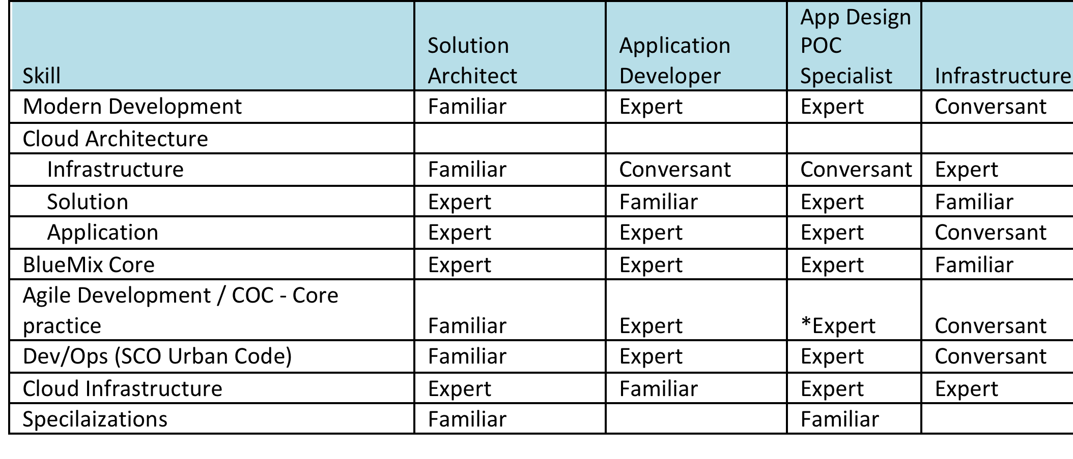
Resource Technical Fluency by Role

Slide 12
Resource Focus by Architecture Role
Solution Architect
Decision Points for on-prem/hosted.public
Decision points for IAAS/PASS/IAS++ (Bluemix,ICO/Pure, Alchemay, Softlayer
Decision points for organizational adoption (dev/Ops/Agile Adoption, new roles, skills, etc)
Application constraint roles (migration, develop internal servides, skills, existing app patterns/architectures)
Business Objectives for cloud adoption
Infrastructure/cross-cutting issues
Product Architecture
High Availability and Disaster Recovery
Cloud Integration / Capture
Migrate 3rd party services
Infrastructure Architect
Patterns vs Bluemix vs Containers vs existing constraints
Deployment Architecture of BlueMix
Soflayer Pod Architecture
ICO Installation and OpenStack configuration
UCD architect (scalability, ops)
Networkng constraints (on prem, VPN, etc)
Public vs Private services Development
Security Constraints
Storage integration
Backup and HA/DR setup
Operational Integration (Monitoring, Service Engagement, 3rd party, etc)
Product Deployment Architecture (ICO, UCD)
Application Architect
services (SOA, microservices)
12 factor / 9 roles
Persistence constraints
UI Modeling
SDK Wrapping
Application Security
Application Scaling issues
Application Peformance Issues
Application level HA constraints

Slide 13
Resource Technical Skills
Java
JavaScript
HTML/5/CSS3
Native App
Node.js
Common JS Libs
angular / polymer
karma / protraction
Spring
JEE Web Profile
JUNIT
Additional Languages
Ruby
Ruby/Rails
Sinatio
Bundler
Touch DB/ NoSQL
Grunt
Bower
MPM
Cocoa Pods
Agile Dev
Jenkins
Maven
Ant
XP/TDD/Refactoring
Lean Startup
Lean UX

Slide 14
Resource Bluemix Specific Skills
CF - Core Architecture for deploy, CF, containers, VMs
Docker/Containers
Public
Dedicated
Local
Runtimes - Java, NodeJS, Ruby
Cloudant SQLDB, ObjectStore, Cche
Monitoring
Pipeline
Autoscale
Alchemy
ACE usage
Community resources
Support Structure
Dev/ PLM Organization

